Slide 2
Topic 3 – Big Data Management Hadoop Ecosystem
ITECH2302 Big Data Management

Slide 3
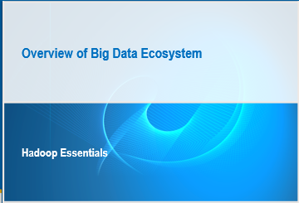

Slide 4
Objectives
Describe big data and the factors that contribute to it.
Define the “three V” characteristics of big data.
Describe the difference between SCALE UP and SCALE OUT.
Describe the difference between traditional data architecture and big data architecture.
Describe the difference between traditional data management and “big data” data management.

Slide 5
What Is Big Data?
“Big data is a collection of data sets so large and complex that it becomes difficult to process using on-hand database management tools.”
Definitions for big data found on Wikipedia:
“Big data is a term used to describe data that cannot be managed and analyzed using traditional infrastructure, architecture, and technologies.”
Notes:
The following definitions found on Wikipedia are attempts at describing big data. The bottom line is that big data is definitely not the typical default data sizes that organizations have been processing for the past several decades. Big data, regardless of how one defines it, is relative to and organization’s existing data management infrastructure and its ability to process that data. For a medium size company, a terabyte of data may be considered big data. To a large company, like a major bank or health care provider, a terabyte is normal, whereas, a petabyte of data is considered big data.

Slide 6
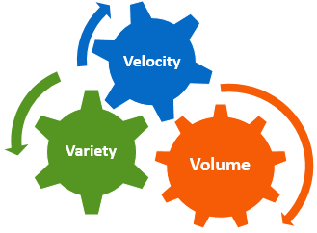
Attributes of Big Data
The following three characteristics make data “big data”:
Volume (Terabytes -> Petabytes)
Velocity (Batch -> Streaming Data)
Variety (Structured -> Unstructured)
Notes:
When people talk about big data, typically three common attributes or characteristics of big data come to mind.
Volume is the overall size of the data being collected.
Velocity is the frequency at which the data is arriving.
Variety is the breadth of the data coming in from multiple sources.
A fourth attribute, not shown on this slide is VALUE. Organization strive to find value in big data through the use of analytics and analysis. The value of big data, though miniscule, may be a differentiator against a organization’s competition.

Slide 7
Big Data Estimates for Three Vs
>3500 petabytes in North America
>3000 petabytes for rest of the world
Volume
People (web, social media, e-commerce, music, videos, messaging)
Machines (sensors, medical devices, GPS)
Variety
About 3 million emails per second
200,000 logins on Facebook every minute
Millions of stock trades in seconds
Velocity
Notes:
As we look at the estimates in growth of the three attributes of big data, we see these numbers in volume, variety, and velocity continue to rise from year to year. What once took a month to generate, individuals generate the equivalent amount of data in an hour using internet applications like Facebook, Amazon, and on-line banking.

Slide 8
Big Data Variety
Big data consists of structured and unstructured data. It is estimated that almost 90% of “big data” comes from unstructured data.
Structured data
databases
files with schemas
Unstructured data
Videos  Audio
Images  Text
BIG DATA
10%
90%
Notes:
As you might expect, with the growth of the internet and its online applications, most of the big data being generated today is unstructured. Of course, traditional, structure data is being generated by organizations across the globe, as their business systems are typically tied to a relational database that requires a well-defined schema.

Slide 9
Factors Contributing Big Data Growth
Cloud
Social Media
Big Data
Mobile

Slide 10
Emergence of Big Data
Facebook Over 6 million views
LinkedIn
Google 2 million searches
BIG DATA 600,000 GB data transferred globally in 1 minute on the Internet
Flickr
Twitter 100,000 new tweets
Netflix
YouTube 30 hours new video
Pandora
Email 204 million emails

Slide 11
Big Data Sources
Public Data
Social Media
BIG DATA
Enterprise Master Data
Sensor Data
Transaction Data

Slide 12
Big Data Sources: Health Care
Public Data
CMS data
Genome project
Weather data
Social Media
Tweets on epidemics
Facebook comments on side effects
Reviews on services
BIG DATA
Enterprise Master Data
Cost of services
Provider details
Employees
Facilities
Sensor Data
Patient vitals monitoring
Delivery monitoring
Wearable data
Transaction Data
Patients admitted
Claims processed
Patient satisfaction

Slide 13
Big Data Sources: Retail
Public Data
Weather data
Customer complaints
US census data
Social Media
Tweets on customer service
Product recommendations on Facebook
Product reviews
BIG DATA
Enterprise Master Data
Product inventory
Cost or price of products
Employees
Customer information
Sensor Data
Traffic measurement
Weblog
Wi-Fi traffic in stores
Transaction Data
Customer purchases
Financial accounting
Inventory management
Supply Chain

Slide 14
Examples of Companies Using Big Data
Yahoo
Facebook
>4500 nodes
>1000 nodes
60% of jobs run on Apache PIG
Hive-based data warehouse
Log processing, advertising analytics
Reporting, analytics, and machine learning

Slide 15
Quiz
Match the terms with their definitions.
___ Volume
___ Velocity
___ Variety
the breadth of the data coming in from multiple sources
the overall size of the data being collected
the frequency at which the data is arriving
Notes:
B, c, a

Slide 16
Quiz – Correct Answer
Match the terms with their definitions.
b Volume
c Velocity
a Variety
the breadth of the data coming in from multiple sources
the overall size of the data being collected
the frequency at which the data is arriving
Notes:
B, c, a

Slide 17
Enterprise Challenges Due to Big Data
Big data users encounter many challenges.
Big Data Challenges

Slide 18
Enterprise Challenges Due to Big Data
Big data users encounter many challenges.
Missing SLAs
Data Latency
Scalability
Big Data Challenges
ETL Challenges
Cost
Growing Unstructured Data

Slide 19

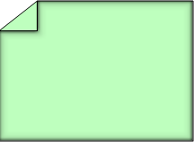

Traditional Data Processing: Architecture
In the traditional data processing model, data moves to the physical hardware that contains the application logic.
Application
Logic applied on the data fetched
Client
Data

Slide 20
Traditional Data Processing: Big Data Impact
In traditional data processing models, with big data, it is possible that the application logic or hardware (or both) that it runs on cannot handle the volume.
Application
Logic applied on the data fetched
Client
Data
Server cannot handle the volume!
Database cannot handle the volume!

Slide 21


Big Data Processing: Architecture
With big data processing, the logic is taken to the data.
Data Node
Logic
Data Node
Logic
Application
Logic
Data Node
Client
Master Node
Logic
Data Node
Logic
Data Node

Slide 22


Traditional Data Management
In traditional data management, the data schema is applied on WRITE.
Load data into structured database
(RDBMS)
Raw data from source systems
Apply schema on WRITE

Slide 23
Big Data Management
In big data management, the schema is applied on READ.
Load data into distributed systems in files
NO SCHEMA
Raw data from source systems
Apply schema on READ

Slide 24

Idea Exchange
Which data management approach, traditional or big data, has the most drawbacks, and why?

Slide 25
Big Data Economics and Key Drivers
Storage Costs
CPU Costs
Hadoop
Lucene
Linux
Bandwidth Costs
Hardware Cost Reduction
Open-Source Technologies

Slide 26
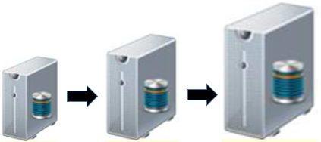
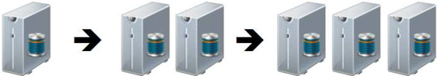
Data Processing Models
Two distinct data processing models can be followed:
Scale up by adding bigger, more powerful processing machines.
Scale out by taking advantage of existing hardware already in inventory, or by purchasing more of the smaller, less expensive machines.

Slide 27
Scale Up versus Scale Out
A decision to either scale up or scale out should be made. Compare costs versus hardware versus other considerations.
 | Scale Up | Scale Out
Cost | Expensive | Cheap
Hardware | Specialized | Commodity
Fault Tolerance | Low | High
Licensing | Proprietary | Open source and proprietary options
Storage | Terabytes | Petabytes and more

Slide 28
Big Data versus Traditional Technologies
Traditional Data Systems
Big Data Technologies
Rigid data models
Weak fault-tolerance architecture
Scalability constraints
Expensive to scale
Limitation for handling unstructured data
Proprietary hardware and software
Schema free
Strong fault-tolerance architecture
Highly scalable
Economical (1TB ~ 5K)
Can handle unstructured data
Commodity hardware and open-source and proprietary software

Slide 29
Summary of Big Data Ecosystem
Big data ecosystems have the following characteristics:
Data volumes are exploding.
Volume, variety, and velocity vary greatly for big data.
Hadoop is an example of a scale-out model.
Decreasing commodity hardware costs make Hadoop a leading platform for big data.
No schema, schema-less, and unstructured data can be handled.

Slide 30
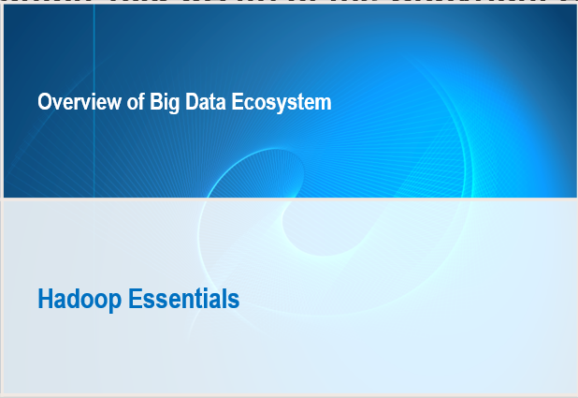

Slide 31
Objectives
Provide an overview of Hadoop.
Describe several aspects of the Hadoop ecosystem
Nodes in the Hadoop cluster
Hadoop Distributed File System (HDFS)
The Hadoop User Experience (HUE) application
MapReduce and Data Processing
Sqoop features and capabilities.

Slide 32
Hadoop
Hadoop is a software framework with these capabilities:
offers reliable, scalable, distributed computing
enables the distributed processing of large data sets across clusters of computers using simple programming models
designed to scale up from single servers to thousands of machines, each offering local computation and storage
 See http://hadoop.apache.org.

Slide 33
History of Hadoop
Inventors: Doug Cutting and Mike Cafarella
Publications that inspired Hadoop:
2004 – MapReduce: Simplified Data Processing on Large Clusters by Jeffrey Dean and Sanjay Ghemawat https://www.usenix.org/legacy/publications/library/proceedings/osdi04/tech/full_papers/dean/dean_html/index.html
2006 – Bigtable: A Distributed Storage System for Structured Data by Fay Chang, Jeffrey Dean, Sanjay Ghemawat, Wilson C. Hsieh, Deborah A. Wallach, Mike Burrows, Tushar Chandra, Andrew Fikes, and Robert E. Gruber http://static.googleusercontent.com/external_content/untrusted_dlcp/research.google.com/en/us/archive/bigtable-osdi06.pdf

Slide 34
Why Apache Hadoop?
open source
simple to use distributed file system
supports highly parallel processing
scalable, so it is suitable for massive amounts of data
designed to work on low-cost hardware
fault tolerant at the data level
existing interfaces that make it familiar to existing SAS customers
the file storage system for SAS LASR Analytic Server
Hadoop
Notes:
The most significant new technology for working with Big Data is Apache Hadoop. Many large organizations have already incorporated Hadoop into their process for analyzing large volumes of data. The open and extensible framework supports a large array of tools to integrate with the Hadoop framework.
Hadoop has several key features that make it very attractive as part of a Big Data technology solution:
Open-source
Simple to use, distributed file storage system
Supports highly-parallel processing - makes it well-suited for performing analysis on huge volumes of data
Scales up well to handle massive amounts of data – it is easily extensible by adding more storage nodes into the cluster
Designed to work on low-cost hardware, so cost-entry point is fairly low
Data is replicated across multiple hosts/nodes to make it fault tolerant
SAS has integration points that make using Hadoop familiar to existing SAS customers - procedures, libnames, DI Studio transforms
Hadoop is the file storage system for the SAS LASR Analytic Server.

Slide 35
Primary Uses for Hadoop
POS system data analysis
analysis of online customer behavior data
improving customer service
operational data analysis
analysis of data from machines or devices
others…
Source: IDC’s Red Hat Hadoop Usage Survey, August 2013
Notes:
The primary uses for Hadoop, according to the IDC's Red Hat Hadoop Usage Survey include:
Point-of-Sale System data analysis
Analysis of on-line customer behavior data
Developing new (and better) services for customers
Operational data analysis
Analysis of data from machines or devices
Others…

Slide 36
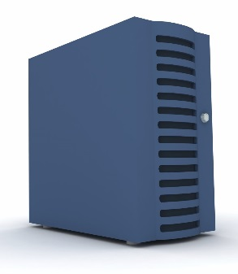
Hadoop Key Features: Distributed Data
Hadoop Cluster
Node 1
Node 2
Very Large
Data File
Data Block 1
Node 3
Data Block 2
Node 4
Data Block 3
Node 5
Notes:
The Hadoop file system was designed to take a data file, spilt it up into blocks, and distribute copies of the blocks of data across the nodes in the cluster. The name node (or head node) in the cluster keeps track of where the files are on the data nodes. Since the data is replicated across the data nodes, the data will not be lost if one of the nodes in the cluster stops working.
Additional data nodes can be added to the cluster to increase processing performance and redundancy.
The number of times the data gets replicated across the nodes is a configurable option in the Hadoop environment.

Slide 37


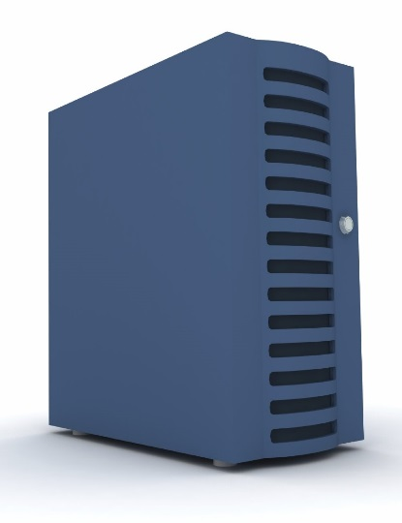
Hadoop Key Features: Distributed Processes
Hadoop Cluster
Node 1
Data Process
Hadoop Head Node
Node 2
Node 3
Node 4
Node 5
Notes:
The Hadoop file system was designed to take processes and spilt them up across the nodes in the cluster. This allows multiple processes to run in parallel across different blocks of data simultaneously.
The name node (or head node) in the cluster keeps track of where the processes are running on the data nodes, and assembles results back from each node.

Slide 38
Hadoop Distributions
Several commercial vendors provide, support, and augment Apache Hadoop with their own distributions. These include the following:
Cloudera
Hortonworks
BigInsights
MapR
Notes:
There are multiple distributions available, including:
Cloudera
Hortonworks
BigInsights
MapR

Slide 39
The Hadoop Ecosystem
The Apache Hadoop core technologies of HDFS, Yarn, and MapReduce, with additional projects including Pig, Hive, and others, are collectively called the Hadoop ecosystem.
Apache
HBase
Hive
Sqoop
Hadoop
BIG DATA
Pig
ZooKeeper
Mahout
Notes:
Some key terms you will need to be familiar with when working with a Hadoop environment include:
HDFS (Hadoop Distributed File System - a distributed file system that is specifically designed to run on commodity hardware.
Yarn – responsible for managing the resources in the Hadoop cluster
MapReduce – Hadoop’s method of splitting processes into the nodes of a Hadoop cluster (Map) and subsequently collecting the results from each node (Reduce).
There are numerous applications and language components available for interacting with Hadoop, including:
Hive – SQL-like query language
HBASE – is the Database of Hadoop
PIG – High-level programming language
SQOOP - Sqoop is a tool designed to import data from relational databases into Hadoop. Sqoop uses JDBC to connect to a database.
ZooKeeper - toolkit for interacting with the Hadoop File System
Mahout – data mining library for Hadoop particularly used for recommender engines

Slide 40






e.g. SAS and Hadoop
SAS Visual Analytics
SAS In-Memory Statistics for Hadoop
SAS Enterprise
Guide
SAS Data Integration
SAS Enterprise Miner
User Interface
SAS User
SAS Metadata
Next Generation
SAS User
Metadata
Base SAS and
SAS/ACCESS Interface to Hadoop
In-Memory
Data Access
Data Access
Pig
Hive
SAS Embedded
Process
Accelerators
SAS LASR
Analytic
Server
SAS High-Performance
Analytic Procedures
Data Processing
MPI Based
Map Reduce
File System
HDFS
Notes:
The SAS / Hadoop ecosystem offers a broad portfolio of capabilities to address the needs of existing SAS users as well as the next generation of users… the SAS Visual Analytics user. Key to that strategy is allowing existing customers to leverage their current investment in SAS, while also addressing the challenges associated with Big Data.
Specifically, SAS users have the ability to incorporate Hadoop into existing processes through:
File System – Access into the Hadoop file system from within SAS, is available in a variety of ways, including through Map Reduce code (Pig and Hive) as well as SAS High-Performance Analytic Procedures.
Data Processing – Data processing can also take place in a variety of ways, including Pig, Hive, SAS Embedded Processes and for the new generation of SAS user, through the SAS LASR Analytic Server.
Data Access – SAS Access to Hadoop is the core component / product which opens up the world of Hadoop to your SAS community, providing common libname support that a SAS user is familiar with. For the new generation of SAS user, the in-memory data access through the SAS LASR Analytic Server provide access to data stored in the Hadoop cluster.
Metadata - SAS Metadata server provides a single managed interface to data in Hadoop consumable by any SAS client.
User Interfaces – There are a number of user interfaces that are available to interact with Hadoop, taking advantage of the SAS Metadata that manages the access to the data in the Hadoop cluster.

Slide 41
Major Releases – V1.x and V2.x
2005 – V1.x
Hadoop Common – libraries and utilities
Hadoop Distributed File System – (HDFS) distributed file system that stores data
Hadoop Map Reduce – programming model
2013 – V2.x
Hadoop Common
Hadoop Distributed File System
Hadoop YARN – resource management platform (Yet Another Resource Negotiator)
Hadoop Map Reduce

Slide 42
Grasping Hadoop Essentials
To gain a perspective of Hadoop and some of the key parts that are involved, this section discusses five main topics.
HDFS
HUE
Hadoop Ecosystem
SQOOP
MapReduce

Slide 43
Hadoop Ecosystem
Multiple software components operate within a distributed Hadoop framework.
HDFS
HUE
Hadoop Ecosystem
SQOOP
MapReduce

Slide 44
Hadoop – Name Node (NN)
In the Hadoop ecosystem, the Name node
is the centerpiece of an HDFS file system
has RAM, CPU, and storage
is usually more powerful (CPU, RAM) than a Data node
stores HDFS file metadata to keep track of data in the HDFS directories across the Data nodes
does not store the data
can host a Job Tracker.
NN

Slide 45
Hadoop – Data Node (DN)
In the Hadoop ecosystem, the Data node
has RAM, CPU, and storage
stores and processes data locally
has data that can be replicated to it (optional)
hosts a Task Tracker.
NN
DN
The Name node and Data node should always be configured on separate machines.

Slide 46
Hadoop – Client Node (C)
The Client node, also called the Edge node or Access node, has the following attributes:
is an access point for non-administrative Hadoop users, such as developers
contains the Hadoop access components (for example, JAR and XML files) that identify and connect to the Hadoop cluster
does not have any role in the Hadoop cluster, such as running Hadoop services
NN
DN
Training environment where the client node resides on the data node.
C

Slide 47
Hadoop Architectures
Ex 1
NN
DN
Ex 2
NN
DN
C
C
Ex 3
DN
DN
NN
DN
C
Ex 1: 1 Name Node, 1 Data Node, and 1 External Client
Ex 2: 1 Name Node, 3 Data Nodes, and 1 External Client
Ex 3: 1 Name Node, 1 Data Node serving as Client (Test Cluster)

Slide 48


HDFS – Hadoop Distributed File System
HDFS
Client
1
NN
DN
2
HDFS client node checks in with the Name node.
HDFS transfers file split to the Data node.

Slide 49
Splits and Replication
A
B
A file is split into small chunks (64MB, 128MB, and so on) and copied across the cluster.
Data can be replicated. (optional)
The recommended replication is 3 for production systems.
- 5 chunks A2, A5, B1, B3, B3
- 2 chunks A5, B1
NN
1
2
3
4
5

Slide 50
Hadoop File System (HDFS)
The file system is based on Java. It provides scalable and reliable data storage across clusters of commodity servers.
HDFS
HUE
Hadoop Ecosystem
SQOOP
MapReduce

Slide 51
HDFS – Home Folder
The HDFS home folder includes the following:
Each home folder directory contains a .Trash subdirectory to keep deleted files for a period of time.
Data in .Trash directories can be purged on demand or purging can be automated.

Slide 52
HDFS – lS, GET, and PUT Commands
When you list the contents of a directory on HDFS, by default, the “home” directory of the current user is listed.
Copy a local file to an HDFS directory.
Copy an HDFS file to a local directory.
$ hdfs dfs –ls
$ hdfs dfs –put <localfile> <hdfs-loc>
$ hdfs dfs –get <hdfs-file> <local-folder>

Slide 53
HDFS – More Common Commands
Access the contents of a file on HDFS.
Access the contents at the bottom of a file.
Remove (delete) a file from Hadoop.
Recursively remove a file from Hadoop.
$ hdfs dfs –cat <file>
$ hdfs dfs –tail <file>
$ hdfs dfs –rm <hdfs-file>
$ hdfs dfs –rm -r <hdfs-file>

Slide 54
Hadoop User Experience (HUE)
To gain a perspective of Hadoop and all parts involved, this section discusses five main topics.
HDFS
HUE
Hadoop Ecosystem
SQOOP
MapReduce

Slide 55
Introduction to Hue
Hue attributes include the following:
Hue: Hadoop User Experience
a web-based interface that enables users to perform a variety of tasks in Hadoop
created by the founders of Cloudera
now an Apache Open Source
Classroom Environment
Windows
Client
NN
DN
C
Hue

Slide 56
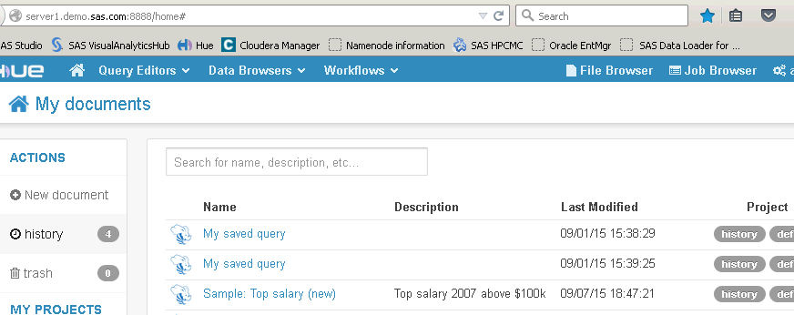
Hue Components
The Hue interface into the Hadoop cluster includes the following:
File Browser – used to manage files in HDFS
Query Editors – used to submit Hive and Pig programs
Job Browser – used to view and manage jobs running on the cluster

Slide 57
MapReduce
MapReduce is a software system for parallel processing of distributed data in HDFS.
HDFS
HUE
Hadoop Ecosystem
SQOOP
MapReduce

Slide 58
Hadoop Data Processing Trackers
Hadoop Data Processing Trackers include the following:
Job Tracker
manages resources and the Task Tracker
Task Tracker
takes orders from Job Tracker
updates Job Tracker

Slide 59
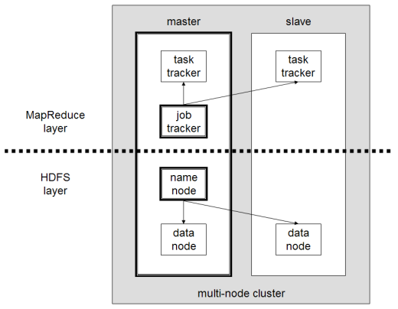
Hadoop Data Processing – MapReduce
Root
Worker
Notes:
MapReduce Processing Using Job and Task Tracker steps:
MapReduce program instantiates a JobClient (primary interface for the user-job to interact with the cluster).
JobClient submits the job to the Job Tracker.
The job tracker creates a set of map and reduce tasks which get sent to the appropriate task trackers.
The task tracker launches a child process which runs the map or reduce task.
The task continuously updates the task tracker with status, counters and writes its output to its context.
Task trackers send heartbeats to the job tracker with information such as status, counters, and data read/write status.
The Task Track heartbeats tell the Job Tracker which Task Trackers are alive.
If Job Tracker stops receiving heartbeats from a Task Tracker, the Job Tracker:
Reschedules tasks on failed Task Tracker to other Task Trackers.
Marks the Task Tracker as unavailable for any subsequent scheduled tasks
Diagram Reference: https://www.cs.colorado.edu/~kena/classes/5448/s11/presentations/hadoop.pdf

Slide 60
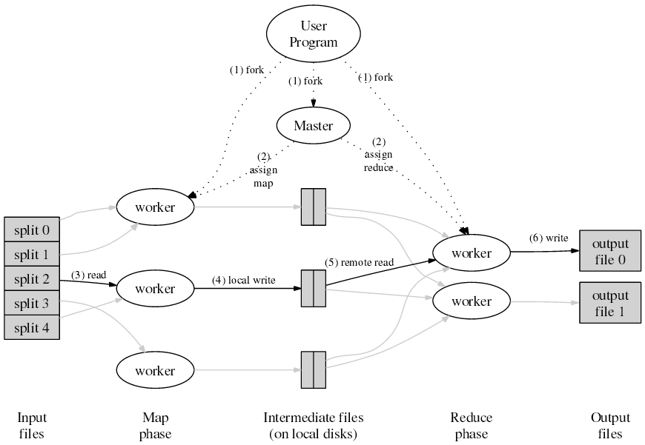
MapReduce Processing
Reference: http://code.google.com/edu/parallel/mapreduce-tutorial.html
Notes:
Example of counting the number of occurrences of each word in a file where the data is split across 5 blocks (splits) on the Hadoop cluster. When the user program is executed to process the data, map phase worker jobs, intermediate files, and reduce phase worker jobs are created at different stages during the processing.
Input file 1: hello
world
hello
moon
goodbye
world
goodnight
moon
Three operations to perform: MAP, COMBINE, and REDUCE
MAP
First map: < hello, 1 >
< world, 1 >
< hello, 1 >
< moon, 1 >
Second map: < goodbye, 1 >
< world, 1 >
< goodnight, 1 >
< moon, 1>
COMBINE (shuffle and sort)
First map: < moon, 1 >
< world, 1 >
< hello, 2>
Second map: < goodbye, 1 >
< world, 1 >
< goodnight, 1 >
< moon, 1 >
REDUCE < goodbye, 1 >
< goodnight, 1 >
< moon, 2 >
< world, 2 >
< hello, 2 >
Reference: https://www.cs.colorado.edu/~kena/classes/5448/s11/presentations/hadoop.pdf

Slide 61
YARN – Yet Another Resource Negotiator
Pig
Hive
HBase
Pig
Hive
HBase
Not
MR
MapReduce
MapReduce
YARN
HDFS
HDFS
Hadoop 1.x
Hadoop 2.x
Notes:
YARN is a resource manager that supports more recent versions of many Hadoop engines and frameworks, allowing resources to be allocated and reallocated for different concurrent applications sharing a cluster.
Existing MapReduce applications can run on YARN without any changes.
MapReduce is now merely another application on YARN, allowing it to change without consideration of the YARN infrastructure.

Slide 62
SQL to Hadoop – Sqoop
Sqoop is a command-line interface application for transferring data between relational databases and Hadoop.
HDFS
HUE
Hadoop Ecosystem
Sqoop
MapReduce

Slide 63
Sqoop – Moving RDBMS Data into Hadoop
Sqoop provides the following capabilities:
is a framework designed for efficiently transferring bulk data between Hadoop and structured, relational databases (for example, MySQL and Oracle)
relies on the database to describe the schema for the data to be imported
uses MapReduce to import and export the data

Slide 64
Sqoop – Import into Hadoop
Sqoop import capabilities are as follows:
Sqoop statements are executed on the Client node
Sqoop statements are converted into Java programs, compiled, and bundled as JAR (Java archive) files.
JAR files are executed as Map tasks.
Map tasks open a JDBC connection to the database directly.
HADOOP
C
RDBMS

Slide 65
Sqoop – Import Syntax
$ sqoop import \
--connect jdbc:mysql://localhost:port/db \
--username foo \
--table TEST
JDBC connection to database server
Example:
sqoop import \
--connect jdbc:mysql://client.demo.sas.com:3306/test \
--username student --password Metadata0 \
--table test_table \
--target-dir /user/student/test_table

Slide 66
Sqoop – Export Out of Hadoop
Sqoop export capabilities are as follows:
Sqoop statements are executed on the Client node, which is similar to import.
JAR files are executed as Map tasks.
Map tasks open a JDBC connection to the database directly.
Failed Map tasks are re-tried at least three times before erroring out.
HADOOP
C
RDBMS

Slide 67
Sqoop – Export Syntax
$ sqoop export \
--connect jdbc:mysql://localhost:port/db \
--table bar \
--export-dir /results/bar_data
Sqoop export run-time characteristics:
Sqoop export is not recommended because the data is uploaded out of the cluster. Keep data in the cluster if possible.
Sqoop tries multiple times in case of failures that would lead to inconsistent data in the table.
Exporting a file from HDFS and batch load using native database tool might be more efficient.

Slide 68
Sqoop – Query-Based Import
Example:
sqoop import –connect \ jdbc:mysql://client.demo.sas.com:3306/test \
--username student --password Metadata0 \
--target-dir /user/student/test_table_query \
--query "select col2, col1 from test_table \
where col1 > 0 and \$CONDITIONS"
Notes:
The $CONDITIONS sets a 1=0 condition that will never be true in the query to support fetching the data in parallel threads.

Slide 69
Summary of Big Data Ecosystem and Hadoop
Hadoop is a widely-used open-source ecosystem of software for big data management and analysis
Some Hadoop ecosystem components include the following:
HDFS (distributed storage) and MapReduce (distributed processing)
Job Tracker
Task Tracker
HDFS – Hadoop File System
Name node
Data node
Hue – web interface utility to Hadoop
Sqoop – data movement in and out of Hadoop

Slide 70
End of the lecture
Questions, comments
Notes:
70

